Slide 1


Shoot The Numbers Team – Ak Skill
An Alexa Skill
BY:
Avi Kathuria

Slide 2
Theme – Create Fun, Immersive Voice First Game to engage Alexa users for at least 3 minutes
My Idea – Shoot the numbers
Unique – Not Available on Alexa Skill Store
Engaging – Random numbers keep the momentum
Scoring – Level wise scoring done (6 levels, at present stage)
Badges – Badges will be given as beginner, intermediate and professional.
Simple Interaction – Answer the no. or shoot if it’s a multiple of 5, 3, 7*.
Music – Engaging music on given on game over and shooting
Images – Image will guide the whole play for echo shoe & dot devices

Slide 3
Basic Features
STOP
CANCEL
HELP

Slide 4
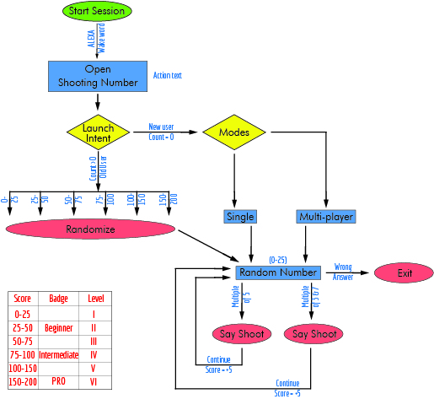
Flow Diagram

Slide 5
Technical Details
Skill ID - amzn1.ask.skill.da27a887-b7be-4d4e-9e69-295cda0272e0
Backend – Node.js
Database – Amazon Dynamo db Services
Storage – Amazon S3 Management Console
Computation – Amazon Lambda Function
Email Id – avikathuria21@gmail.com

Slide 6
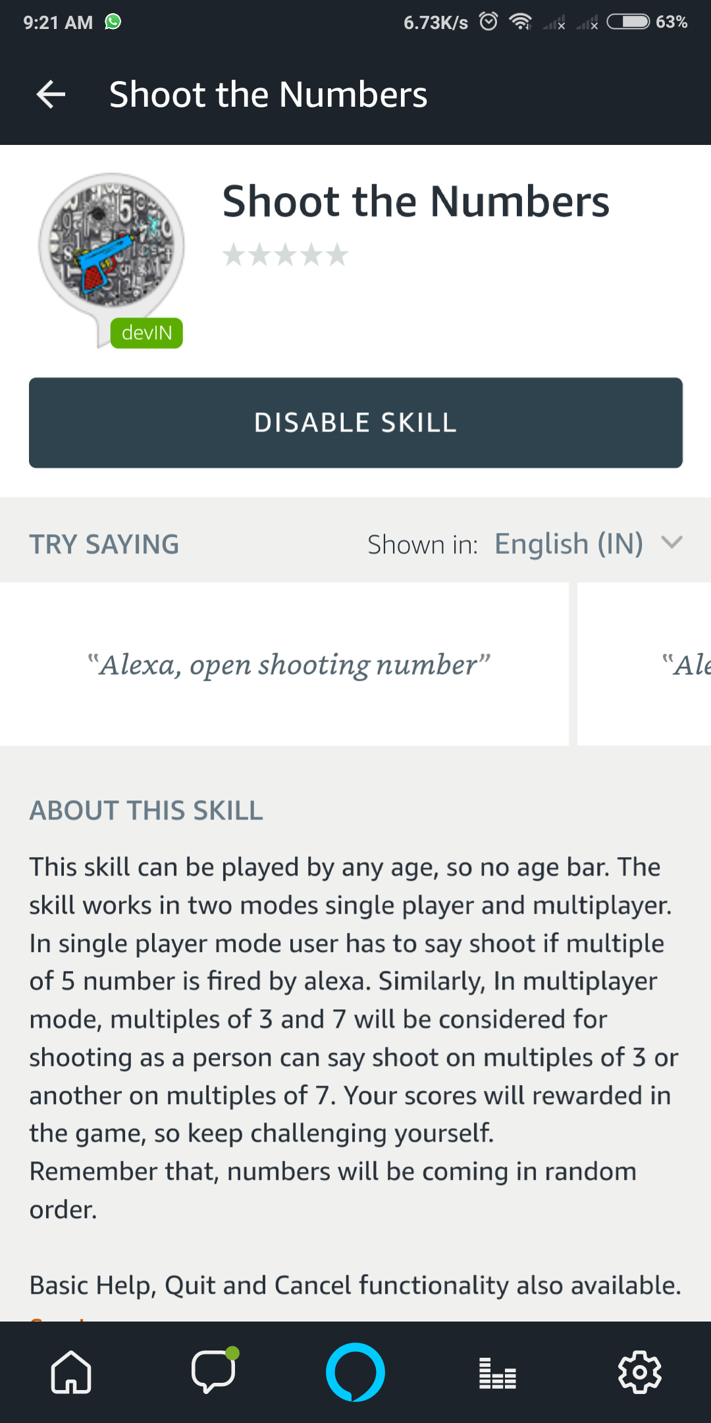
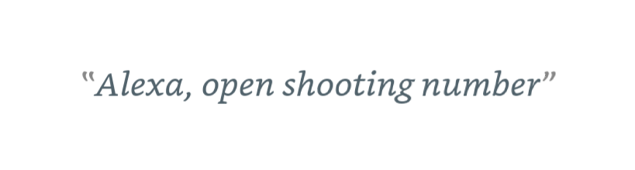
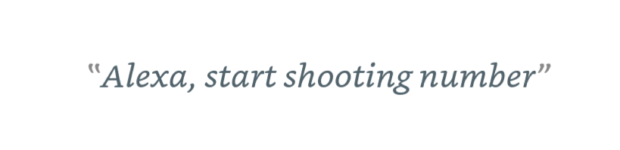
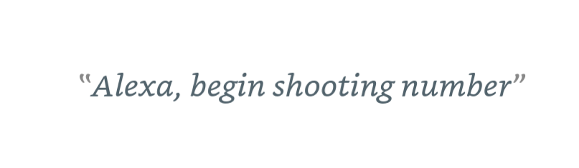
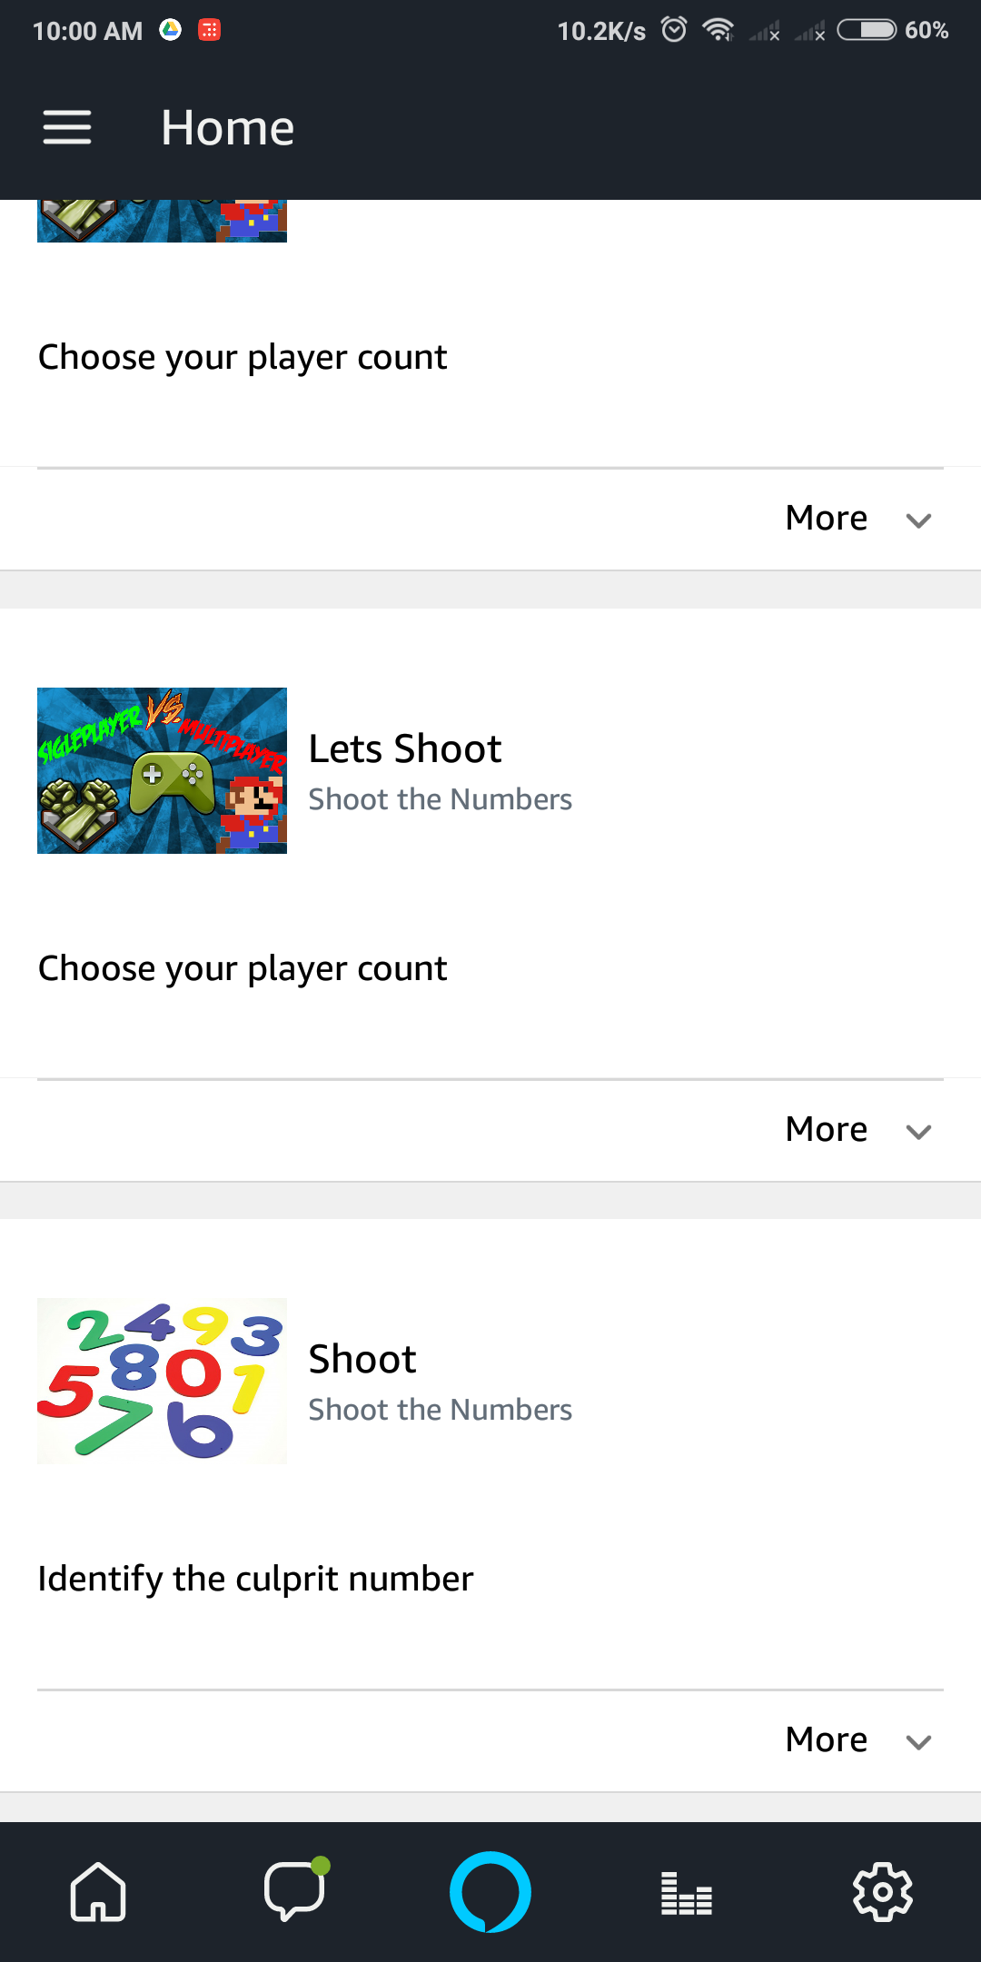
Screenshots

Slide 7
Thank You

